Slide 1
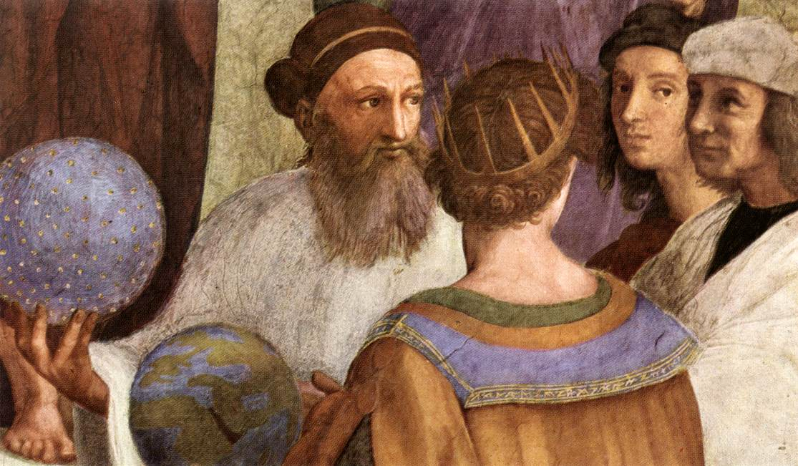

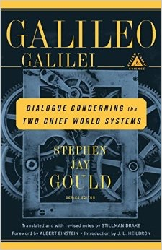
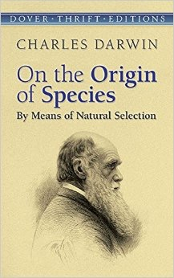
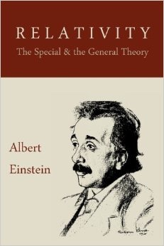
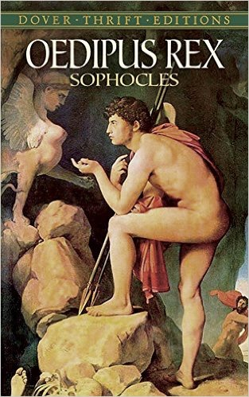

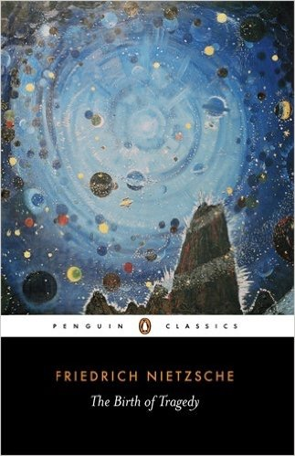



Continuing Our Conversation
Jared Chance Taylor
Dr. Don Thompson
The Great Books Colloquium; Pepperdine University
April 1, 2016
The Sciences
Summary
At present, the Great Books Colloquium at Pepperdine University successfully provides its students with a vast overview of human progress, inspiring a depth of inquiry and sense of wonder that students would not otherwise cultivate. Through dialogue, these classes connect the four-thousand year old words of Plato with our current notions of truth, beauty, and goodness—proving just how timeless such ideas are to the human heart. This touching of worlds is arguably the focal point of any liberal arts education. Great Books reveals the Primum Mobile hidden behind the content of Pepperdine’s typical gen. ed. courses, allowing students to meet their education with a new sense of ownership. Better yet, this educational sensation has even further potential to permeate through fields such as Fine Arts, History, and Science. One must not forget that the art, histories, and discoveries of centuries past are all responses to the ideas put forth from the Great Books—just as such ideas were composed in response to prior advancements in these fields. Needless to say, these media engage in direct dialogue with one another. Therefore, we have every reason to investigate this relationship.
Our goal is to stretch the potential of such a wonder by creating a Great Books Minor and a Gen. Ed. Honors Program based on the Great Books program, accomplishing necessary requirements with fewer classes. No other program at Pepperdine University inspires the independence of thought that the Great Books Colloquium encourages. In addition to developing communicative skills crucial for scholarly discussion, Great Books courses naturally develop curiosity, critical thinking, and the creativity to transmit its contents to seemingly outside spheres. Great Books and the aforementioned fields of study do not reside in separate arenas. As said, they participate in dialogue. Just as one studying music examines an array of topics pertaining to music in order to gain musical expertise, so one studying the Great Books may examine a wide variety of topics, ranging across the scholarly spectrum, in order to gain a new and noble expertise: the beautiful quality of enjoying life, and all that it encompasses, for its own sake. Such an attribute informs any purpose, freely invites any opportunity for service, and boldly communicates leadership. In an age when so many of us are becoming shackled to screens, where it is too easy to be anywhere but the present moment, such a disposition is becoming all the more essential—in both the realm of character and the realm of the professional. For this reason, both the Great Books minor and the Gen. Ed. Honors Program is capable of equipping students with the insight, independence, and character necessary for a young adult to thrive amidst the flux and flow of our professional world.
Abstract
We present a synopsis of the current Great Books Colloquium, comprised of five courses: four in Western Literature and Philosophy, one in Asian Literature & Philosophy, and indicate how these courses carry on the Great Conversation from the viewpoint of signal works in the Western and Eastern Canon. Subsequently we demonstrate how these courses form a kind of incomplete core for the classic liberal arts. Accordingly, our work introduces, details and proposes three additional courses in the Great Books, forming a Great Books minor. These courses focus on Science - ranging from Lucretius' On the Nature of Things to Einstein's Relativity, Aesthetics - ranging from Aristotle’s Poetics to Mozart’s Don Giovanni, and Latin America - ranging from Pablo Neruda to Gabriel Garcia Marquez. Our research highlights the interconnection between all eight of these courses, drawing from the curricula of schools like St. John’s College and Williams College.
Physics - Aristotle
On the Nature of Things - Lucretius
Dialogue Concerning the Two Chief World Systems
- Galileo Galilei
Novum Organum - Francis Bacon
Origin of the Species - Charles Darwin
Matter and Motion - James Clerk Maxwell
Relativity - Albert Einstein
A Brief History of Time - Stephen Hawking
The Aesthetics
L’Orfeo - Claudio Monteverdi
Don Giovanni - Wolfgang Amadeus Mozart
The Birth of Tragedy - Friederich Nietzsche
Waiting for Godot - Samuel Beckett
Oedipus Rex - Sophocles
Clouds - Aristophanes
Poetics - Aristotle
A Midsummer Night’s Dream - William Shakespeare
Needs Fulfilled
This work fills two needs: 1) to expand a vital program in our liberal arts/general education program from its current five semester form to an eight semester format in order to continue to challenge and energize the life of the mind that is already in place at Seaver College, spanning all four years of study and allowing students to study the ideas of the Great Books in areas not currently available, and 2) to provide a skein around which an emerging Research Scholars Program can be built that will attract incoming students to an honors experience that will challenge them more broadly than is currently possible and will provide their entre’ into both undergraduate research in the liberal arts as well as post-baccalaureate fellowship and research experiences including the Rhodes Scholarship, Marshall Scholarship, Goldwater Fellowship, and the Fulbright Scholar programs.
LATIN AMERICAN LITERATURE
Translated Christianities: Nahuatl & Maya
Religious Texts
Twenty Love Poems and a Song of Despair
Pablo Neruda
Los árboles mueren de pie - Alejandro Casona
Labyrinths - Jorge Luis Borges
One Hundred Years of Solitude - Gabriel García Márquez
La ciudad y los perros - Mario Vargas Llosa
Hopscotch - Julio Cortázar
The Cave - José Saramago

